Slide 1
DECISION MAKING , MODELING, DECISION MAKING PROCESS AND SUPPORT

Slide 2
Learning Objectives
Understand the conceptual foundations of decision making
Understand Simon’s four phases of decision making: intelligence, design, choice, and implementation
Differentiate between the concepts of making a choice and establishing a principle of choice
Learn how DSS support for decision making can be provided in practice

Slide 3
Decision Making: Introduction and Definitions
Decision Making: a process of choosing among alternative courses of action for the purpose of attaining a goal or goals
Managerial Decision Making is synonymous with the whole process of management (Simon, 1977)

Slide 4
Decision Making: Introduction and Definitions
Decision making disciplines
  Behavioral
  Scientific
Successful decision
  Effectiveness
  The degree of goal attainment. Doing the right things
  Efficiency
  The ratio of output to input. Appropriate use of resources. Doing the things right

Slide 5
Decision Making: Introduction and Definitions
Decision style and decision makers
Decision style
The manner in which a decision maker thinks and reacts to problems. It includes perceptions, cognitive responses, values, and beliefs
  Autocratic
  Democratic
  Consultative

Slide 6
Decision Making: Introduction and Definitions
Decision style and decision makers
  Different decision styles require different types of support
    Individual decision makers need access to data and to experts who can provide advice
    Groups need collaboration tools

Slide 7
Modelling: Models
Models: Major component of DSS
Use models instead of experimenting on the real system
A model is a simplified representation or abstraction of reality.
Reality is generally too complex to copy exactly
Much of the complexity is actually irrelevant in problem solving

Slide 8
The benefits of models
Time compression
Easy model manipulation
Low cost of construction
Low cost of execution (especially that of errors)
Can model risk and uncertainty
Can model large and extremely complex systems with possibly infinite solutions
Enhance and reinforce learning, and enhance training.

Slide 9

The Decision-Making Process
Systematic Decision-Making Process (Simon, 1977)
Intelligence
Design
Choice
Implementation
(Figure in next slide)
Modeling is Essential to the Process

Slide 10
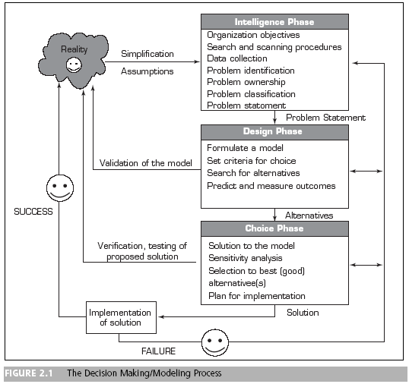
Phases of the Decision Making Process

Slide 11
Decision Making:
The Intelligence Phase
Problem (or opportunity) identification:
Involves data collection
  Some issues that may arise during data collection
    Data are not available
    Obtaining data may be expensive
    Data may not be accurate or precise enough
    Data estimation is often subjective
    Data may be insecure

Slide 12
Decision Making:
The Intelligence Phase
Problem (or opportunity) identification:
Some issues that may arise during data collection
  Important data that influence the results may be qualitative
  Information overload
  Outcomes (or results) may occur over an extended period
  If future data is not consistent with historical data, the nature of the change has to be predicted and included in the analysis

Slide 13
Decision Making:
The Intelligence Phase
Problem classification
The conceptualization of a problem in an attempt to place it in a definable category, possibly leading to a standard solution approach
Problem decomposition
Dividing complex problems into simpler subproblems may help in solving the complex problem
Problem ownership
The jurisdiction (authority) to solve a problem

Slide 14
Decision Making:
The Design Phase
The design phase involves finding or developing and analyzing possible courses of action
  Understanding the problem
  Testing solutions for feasibility
  A model of the decision-making problem is constructed, tested, and validated

Slide 15
Decision Making:
The Design Phase
Modeling involves conceptualizing a problem and abstracting it to quantitative and/or qualitative form
Models have:
  Decision variables
  Principle of choice

Slide 16
Decision Making:
The Design Phase
Decision variables
A variable in a model that can be changed and manipulated by the decision maker. Decision variables correspond to the decisions to be made, such as quantity to produce, amounts of resources to allocate, and so on
Principle of choice
The criterion for making a choice among alternatives

Slide 17
Decision Making:
The Design Phase
Types of Models
Normative models
Models in which the chosen alternative is demonstrably the best of all possible alternatives
  Optimization
  The process of examining all the alternatives and proving that the one selected is the best
  Suboptimization
  An optimization-based procedure that does not consider all the alternatives for or impacts on an organization

Slide 18
Decision Making:
The Design Phase
Descriptive model
A model that describes things as they are
  Simulation
  An imitation of reality
  Narrative is a story that helps a decision maker uncover the important aspects of the situation and leads to better understanding and framing

Slide 19
Decision Making:
The Design Phase
Good enough or satisficing
  Satisficing
  A process by which one seeks a solution that will satisfy a set of constraints. In contrast to optimization, which seeks the best possible solution, satisficing simply seeks a solution that will work well enough

Slide 20
Decision Making:
The Design Phase
Good enough or satisficing
  Reasons for satisficing:
    Time pressures
    Ability to achieve optimization
    Recognition that the marginal benefit of a better solution is not worth the marginal cost to obtain it

Slide 21
Decision Making:
The Design Phase
Developing (generating) alternatives
  In optimization models the alternatives may be generated automatically by the model
  In most MSS situations it is necessary to generate alternatives manually (a lengthy, costly process); issues such as when to stop generating alternatives are very important
  The search for alternatives usually occurs after the criteria for evaluating the alternatives are determined
  The outcome of every proposed alternative must be established

Slide 22
Decision Making:
The Design Phase
Measuring outcomes
  The value of an alternative is evaluated in terms of goal attainment
Risk
  One important task of a decision maker is to attribute a level of risk to the outcome associated with each potential alternative being considered

Slide 23
Decision Making:
The Design Phase
Scenario
A statement of assumptions about the operating environment of a particular system at a given time; a narrative description of the decision-situation setting
  Scenarios are especially helpful in simulations and what-if analyses

Slide 24
Decision Making:
The Design Phase
  Scenarios play an important role in MSS because they:
    Help identify opportunities and problem areas
    Provide flexibility in planning
    Identify the leading edges of changes that management should monitor
    Help validate major modeling assumptions
    Allow the decision maker to explore the behavior of a system through a model
    Help to check the sensitivity of proposed solutions to changes in the environment

Slide 25
Decision Making:
The Design Phase
  Possible scenarios
    The worst possible scenario
    The best possible scenario
    The most likely scenario
    The average scenario

Slide 26
Decision Making:
The Design Phase
Errors in decision making
  The model is a critical component in the decision-making process
  A decision maker may make a number of errors in its development and use
  Validating the model before it is used is critical
  Gathering the right amount of information, with the right level of precision and accuracy is also critical

Slide 27
Decision Making:
The Choice Phase
Solving a decision-making model involves searching for an appropriate course of action
  Analytical techniques (solving a formula)
  Algorithms (step-by-step procedures)
  Heuristics (rules of thumb)

Slide 28
Decision Making:
The Choice Phase
Analytical techniques
Methods that use mathematical formulas to derive an optimal solution directly or to predict a certain result, mainly in solving structured problems
Algorithm
A step-by-step search in which improvement is made at every step until the best solution is found

Slide 29
Decision Making:
The Choice Phase
Heuristics
Informal, judgmental knowledge of an application area that constitutes the rules of good judgment in the field. Heuristics also encompasses the knowledge of how to solve problems efficiently and effectively, how to plan steps in solving a complex problem, how to improve performance, and so forth

Slide 30
Decision Making:
The Implementation Phase
Generic implementation issues important in dealing with MSS include:
  Resistance to change
  Degree of support of top management
  User training

Slide 31
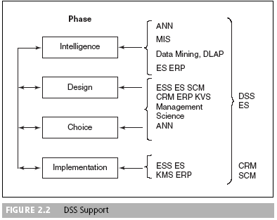
Decision Making:
How Decisions Are Supported

Slide 32
How Decisions Are Supported
Support for the intelligence phase
  The ability to scan external and internal information sources for opportunities and problems and to interpret what the scanning discovers
    Web tools and sources are extremely useful for environmental scanning
    Web browsers provide useful front ends for a variety of tools (OLAP, data mining, data warehouses)
    Internal data sources may be accessible via a corporate intranet
    External sources are many and varied

Slide 33
How Decisions Are Supported
Support for the design phase
  The generation of alternatives for complex problems requires expertise that can be provided only by a human, brainstorming software, or an ES

Slide 34
How Decisions Are Supported
Support for the choice phase
  DSS can support the choice phase through what-if and goal-seeking analyses
  Different scenarios can be tested for the selected option to reinforce the final decision
  KMS helps identify similar past experiences
  CRM, ERP, and SCM systems are used to test the impacts of decisions in establishing their value, leading to an intelligent choice
  An ES can be used to assess the desirability of certain solutions and to recommend an appropriate solution
  A GSS can provide support to lead to consensus in a group

Slide 35
How Decisions Are Supported
Support for the implementation phase
  DSS can be used in implementation activities such as decision communication, explanation, and justification
  DSS benefits are partly due to the vividness and detail of analyses and reports

Slide 36
How Decisions Are Supported
New technology support for decision making
  Mobile commerce (m-commerce)
  Personal devices
    Personal digital assistants [PDAs]
    Cell phones
    Tablet computers
    laptop computers

